Slide 1

#AzureSQL
SQL Server to Azure SQL:
Availability
Anna Hoffman, Data & Applied Scientist / PM
Microsoft Azure Data
October 2020
Notes:
Anna leads, introduces herself and asks Bob to introduce himself
LAYOUT : 2 Person Demo

Slide 2
Agenda
SQL
Overview
Local
Zone
Geo
Scenarios
Summary
Notes:
Anna to explain agenda and pass over to Emily
Intro – Anna – 2-3 min
Overview – Emily - 10 min
Local – Alain -15 min
Zone – Emily – 15 min
Geo – Anna – 10 min
Scenarios – 5 min
Summary – Anna – 5 min

Slide 3



Azure SQL
A unified SQL portfolio built on the industry-leading SQL Server engine
SQL Server on Azure Virtual Machines
Azure SQL Managed Instance
Azure SQL Database
Best for re-hosting and apps requiring OS-level access and control
Automated manageability features and OS-level access
Best for modernizing existing apps
Offers high compatibility with SQL Server and native VNET support
Best for building new apps in the cloud
Pre-provisioned or serverless compute and Hyperscale storage to meet demanding workload requirements
Infrastructure as a Service
Platform as a Service
Overview
Local
Zone
Geo
Scenarios
Summary
Notes:
Emily

Slide 4
Backup and restore
Auto backups and Point in Time Restore (PITR)
Full Database backup once a week
Log Backups every 5-10 minutes
Differential Backups every 12-24 hours
Backup files on Azure storage with RA-GRS replicated
LRS and ZRS also new options!
Backup Integrity checks
Restore to new database
Long-term retention (up to 10 years) of backups
Geo-restore of databases if primary region down
Restore backups of deleted databases
Manual COPY_ONLY Backup/Restore with Managed Instance
Backups retained for 7/35 days
Time
Now
-7 days
Self-service restore to a point in time
DB1
DB1
Overview
Local
Zone
Geo
Scenarios
Summary
Notes:
Layout: 2 Person Desktop TR
Anna but ask Bob about the significance of what we’re doing here
By default, a full database backup is taken once a week, with log backups every 5-10 minutes, and differential backups every 12 hours. These backup files are stored in Azure Storage on read-access geo-redundant storage (RA-GRS). On an ongoing basis, the Azure SQL engineering team automatically tests the restore of automated databases backups of databases placed in logical servers and Elastic pools. For migrating to Azure SQL Managed Instance, an automatic initial backup with CHECKSUM of databases restored with the native RESTORE command or the Azure Database Migration Service is completed. Additionally, in Azure SQL Managed Instance, you can take a native COPY_ONLY backup and store it in Azure Blob storage.
Details for Backup Integrity Checks
On an ongoing basis, the Azure SQL Database engineering team automatically tests the restore of automated database backups of databases placed in logical servers and elastic database pools. (This testing isn't available in managed instance.) Upon point-in-time restore, databases also receive DBCC CHECKDB integrity checks.
Managed instance takes automatic initial backup with CHECKSUM of databases restored with the native RESTORE command or with Azure Data Migration Service after the migration is completed.
Restore to new database
You can deploy a new database also based on a backup
Notes on LTR backups
If you enable LTR policy, the weekly full backups are automatically copied to a different RA-GRS storage container. To meet various compliance requirements, you can select different retention periods for weekly, monthly, and/or yearly backups
LTR not supported on Hyperscale today
Current limits for LTR of backups for Managed Instance
Using long-term backup retention with an Azure SQL Database managed instances has the following limitations:
Limited public preview - This preview is only available to EA and CSP subscriptions and is subject to limited availability.
PowerShell only - There is currently no Azure portal support. LTR must be enabled using PowerShell.
Restore deleted databases
You cannot restore a deletion of a logical server or managed instance. The portal only allows you to restore a deleted database back to the deletion time. You need Powershell or REST to restore a backup of a deleted database from an earlier point of time based on backup retention.

Slide 5
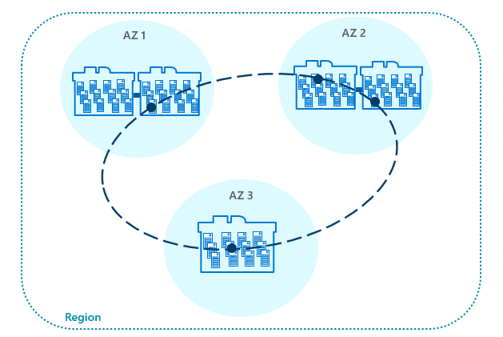
Layers of availability
AZ 1
AZ 2
Local redundancy
Zone redundancy
Geo redundancy
AZ 3
Region
Overview
Local
Zone
Geo
Scenarios
Summary
Notes:
Emily

Slide 6

General Purpose High Availability
Behaves like Failover Cluster Instance
Remote storage provides data redundancy within a datacenter
Backup files are in a different location with geo-redundancy
Failover decisions based on SQL and Service Fabric
Recovery time depends on spare capacity
Connectivity redirection built-in
Azure Region
Application
GW
GW
GW
Control Ring
Primary Replica
Failover
Nodes with spare capacity
SSD, tempdb
SSD, tempdb
Data and log files
Azure premium storage (LRS) data/log
Backup files
Azure standard storage
(RA-GRS)
Overview
Local
Zone
Geo
Scenarios
Summary
Notes:
Alain
Images from docs https://docs.microsoft.com/en-us/azure/sql-database/sql-database-high-availability
Notes:
Behaves like a Failover Cluster Instance
Azure Storage handles redundancy of files (LRS)
SQL coordinates with Service Fabric for failovers
Backups on different storage with GRS
SSD Cache is Azure Blob Cache
Tempdb kept on local storage
Applies to Azure SQL Database and MI
Force failover using Powershell (see more at https://docs.microsoft.com/en-us/powershell/module/az.sql/invoke-azsqldatabasefailover?view=azps-3.8.0) or REST. There are limits on how often you can do this.
Failover Logic
Spin up a new SQL Server instance on a node with availability
Attach SQL Database files
Run Recovery
Gateways updated for new node. No virtual network or listener required

Slide 7
Business Critical High Availability
Based on Always On Availability Groups
3 secondary replicas automatically created
Four replicas kept available
Backup files in a different location with geo-redundancy
At least one secondary must sync for commits
Automatic failover based on SQL and Service Fabric
Recovery time extremely fast
Connectivity redirection built-in
Read Scale-Out from one of the replicas
Azure Region
GW
GW
GW
Application
Control Ring
Secondary Replica
Secondary Replica
SSD, data, log
SSD, data, log
Primary Replica
AlwaysON Availability Group
SSD, data, log
Failover
Secondary Replica
SSD, data, log
Backup files
Azure standard storage
(RA-GRS)
Overview
Local
Zone
Geo
Scenarios
Summary
Notes:
Alain
Image comes from https://docs.microsoft.com/en-us/azure/sql-database/sql-database-high-availability#premium-and-business-critical-service-tier-availability
Four replicas kept available
This is a major benefit to users of Azure. For SQL Server, if a failover occurs, you are responsible to getting the old primary back as a new secondary if the machine is down. In Azure, we just provision a new replica and make it a new secondary.
This is a big difference from default configuration of AGs with SQL Server
At least one secondary must sync for commits
he primary node constantly pushes changes to the secondary nodes in order and ensures that the data is synchronized to at least one secondary replica before committing each transaction. This process guarantees that if the primary node crashes for any reason, there is always a fully synchronized node to fail over to.
Read more about read scale out at https://docs.microsoft.com/en-us/azure/sql-database/sql-database-read-scale-out
Force failover using Powershell (see more at https://docs.microsoft.com/en-us/powershell/module/az.sql/invoke-azsqldatabasefailover?view=azps-3.8.0) or REST. There are limits on how often you can do this.
Important note about read replicas
Read Scale-Out supports session-level consistency. It means, if the read-only session reconnects after a connection error caused by replica unavailability, it may be redirected to a replica that is not 100% up-to-date with the read-write replica. Likewise, if an application writes data using a read-write session and immediately reads it using a read-only session, it is possible that the latest updates are not immediately visible on the replica. The latency is caused by an asynchronous transaction log redo operation.

Slide 8
Demo Faster failovers with Business critical
Notes:
Anna
https://github.com/microsoft/sqlworkshops-azuresqlworkshop/blob/master/azuresqlworkshop/05-Availability/basic-ha/basic-ha.ipynb
Need to have a BC and GP database deployed in order to do side by side

Slide 9
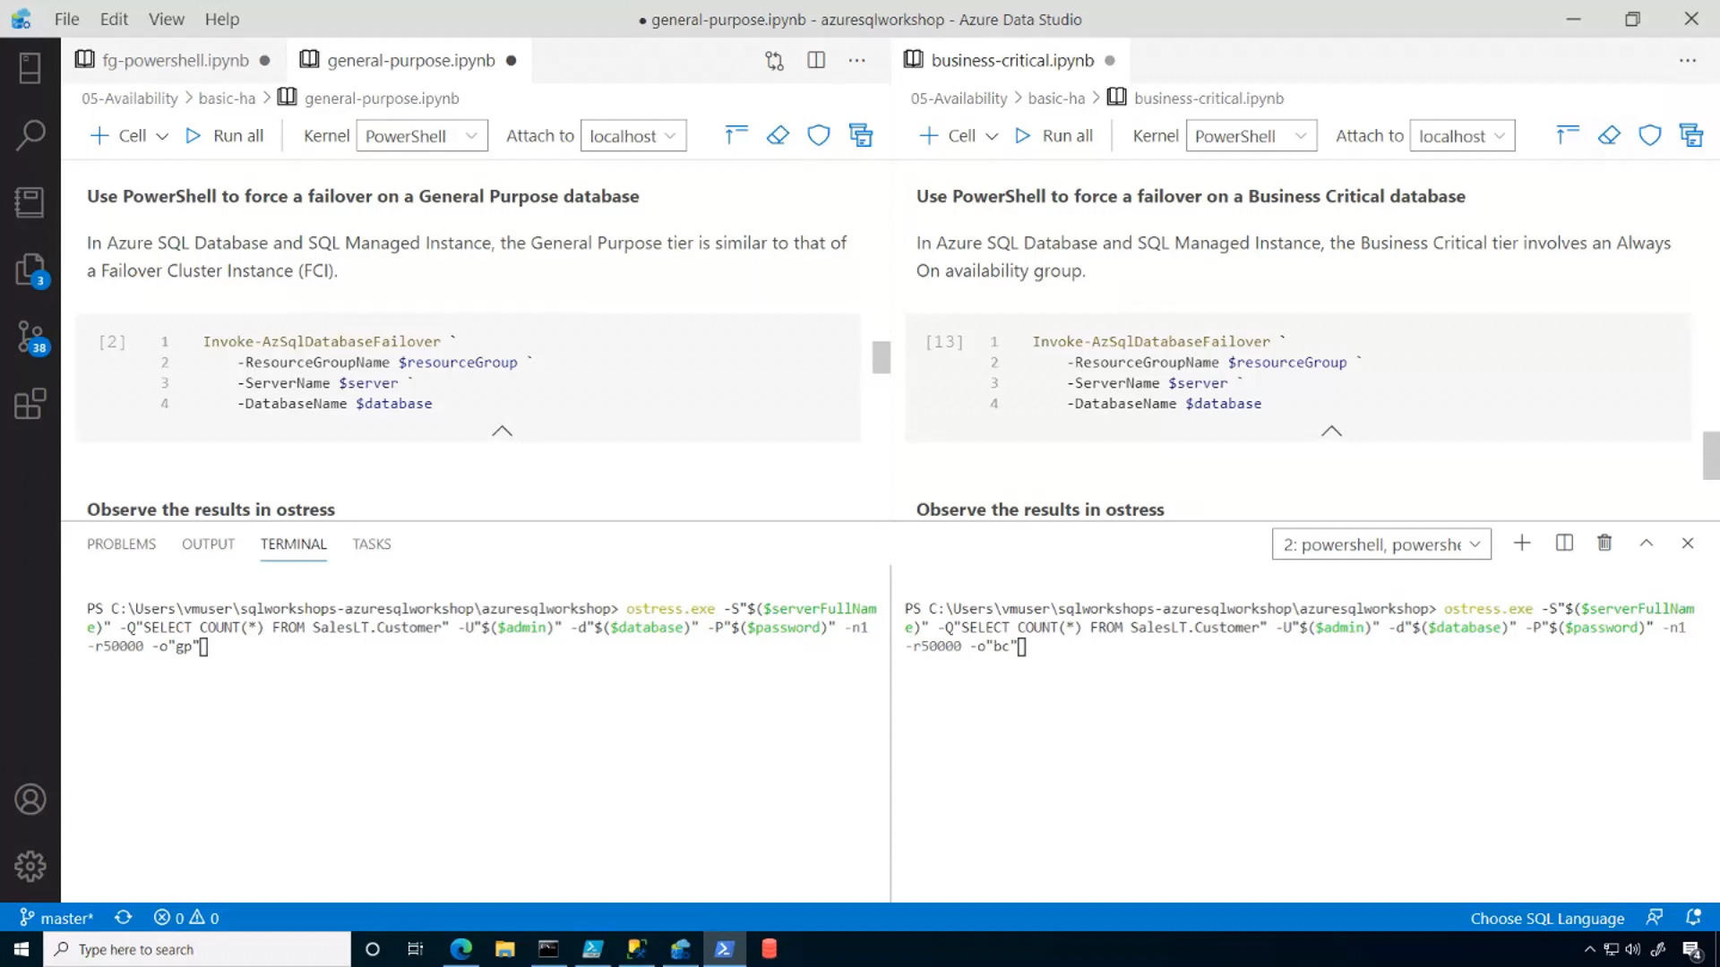

Slide 10

Hyperscale High Availability*
Paired page servers
Redundant log and data through Azure Storage
Backup/Restore snapshots
Log Service feeds replicas
0 to 4 secondary replicas for read scale and failover
Automatic failover based on SQL and Service Fabric
Recovery time depends on existence of replicas
Read-Write
Read-Only
Compute nodes
Primary Compute
Secondary Compute
Secondary Compute
SqlServr.exe
SqlServr.exe
SqlServr.exe
Log Service
RBPEX Data Cache
RBPEX Data Cache
RBPEX Data Cache
Landing Zone
(Azure Premium Storage)
Page Servers
Log Service
Long term log storage for PITR (Azure Standard Storage)
Log Cache
Page Server
Page Server
…
Page Server
RBPEX Data Cache
RBPEX Data Cache
RBPEX Data Cache
Data File
Data File
Data File
Data Pathway
Log Pathway
Snapshots
Snapshots
Snapshots
Local SSD Cache
RBPEX
Resilient Buffer Pool Extension
Azure Standard Storage
*Not in managed instance
Overview
Local
Zone
Geo
Scenarios
Summary
Notes:
Alain
Image from https://docs.microsoft.com/en-us/azure/sql-database/sql-database-service-tier-hyperscale#distributed-functions-architecture
Log Service feeds replicas. Transactions can commit when the log service hardens changes to the Landing Zone. The consumption of changes by a Secondary Compute replica is not required for commit
This technology does not use Always On Availability Groups but does you log records to feed changes to secondary replicas
Recovery time depends on existence of replicas
You are not required to have replicas for Hyperscale. If a replica does not exist, HA is still possible but it behaves more like General Purpose since a new primary replica must be deployed.
Backup/Restore snapshots
Hyperscale data files are on Azure Storage and since we have levels of “caching” we can use snapshots to quickly backup and restore a database even if the size is large.

Slide 11
Demo Read scale with Hyperscale
Notes:
Anna
https://github.com/microsoft/sqlworkshops-azuresqlworkshop/blob/master/azuresqlworkshop/05-Availability/basic-ha/basic-ha.ipynb
Need to have a BC and GP database deployed in order to do side by side

Slide 12
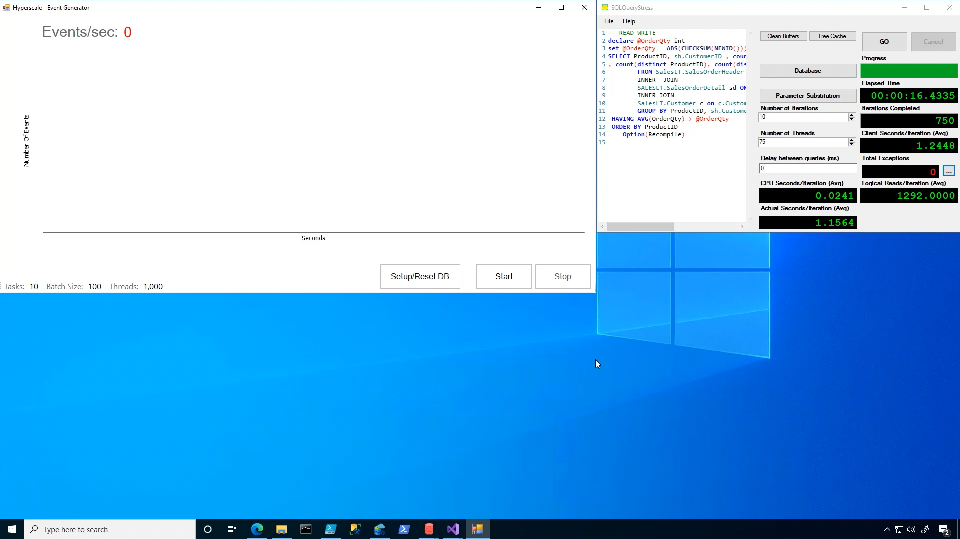

Slide 13
Knowledge check
Which service tier puts the data and log files on Azure premium storage?
A. General purpose
B. Business Critical
C. Hyperscale
D. All of the above
Which service tier has an Always on Availability Group deployed behind the scenes?
A. General purpose
B. Business Critical
C. Hyperscale
D. All of the above
Notes:
Anna to lead
Alain to answer after 1 30 seconds

Slide 14
Service tiers – SQL Database and Managed Instance
General purpose
Business critical
Hyperscale*
Most business workloads
Workloads that require low latency, fast recovery, and a readable secondary
Most business workloads with highly scalable storage and read-scale requirements
Remote storage
Local storage
Local + remote storage
IOPS
$
Serverless*
IOPS++
$$$
In-memory
IOPS+
$$
Unlimited storage
P
P
S
S
R
P
R
R
R
R
*Not in managed instance
Overview
Local
Zone
Geo
Scenarios
Summary
Notes:
Alain
Anna to do transition to zone to Emily

Slide 15
What is an Availability Zone?
Availability Zones is a high availability offering that protects applications against datacenter level failures.
Region
Minimum of three physically separated locations
Three Availability Zones to support quorum-based workloads like SQL, Service Fabric, Cassandra, MongoDB.
Independent power, cooling, network
A facility level failure or single fiber path failure will affect only one zone.
Azure management services replicated across zones
Azure management services are redundant, so a single zone failure will not affect other zones. Azure maintenance orchestrated zone by zone.
Overview
Local
Zone
Geo
Scenarios
Summary
Notes:
Emily
I will start this definition at an even higher level by first defining a region. An Azure region is a set of datacenters deployed within a latency-defined perimeter and connected through a dedicated regional low-latency network.
Availability Zones are unique and physically separate physical locations within an Azure region. To ensure resiliency, there's a minimum of three separate zones in all AZ enabled regions.
Each zone is made up of one or more datacenters equipped with independent power, cooling, and networking.
Zone-redundant configurations are when the Azure platform automatically replicates your service across Availability Zones to protect from single-points-of-failure since one zone failing will not impact the availability of another zone. Azure SQL Database currently offers a zone redundant configuration for the Business Critical and Premium service tiers, lets dive into what this looks like

Slide 16

Zone redundant database – Business Critical & Premium service tiers
Azure Traffic Manager
Replicas are automatically created across zones
Synchronous replication
Database resilient to zonal outage
Free for Business Critical & Premium
Application
AZ 1
AZ 2
AZ 3
GW
GW
GW
GW
GW
GW
GW
GW
GW
Control Ring
Control Ring
Control Ring
Secondary Replica
Secondary Replica
SSD, data, log
AlwaysON Availability Group
SSD, data, log
Primary Replica
Failover
Secondary Replica
SSD, data, log
SSD, data, log
Backup files
Azure standard storage
(RA-GRS)
Overview
Local
Zone
Geo
Scenarios
Summary
Notes:
Emily
Free but also ONLY (today) for BC and Premium. Not available in Managed Instance today. Private Preview today for GP.
Azure Traffic Manager automatically handles routing to correct Gateway. No application logic required.
Some regions are made up of multiple data centers (think campuses)
Availability Zone is or more physical data centers separated from others but close enough for connectivity
Protect your data from “region” issues by using Zones
Only available today for Premium and Business Critical
Not supported for Managed Instance today
Could slow down latency sensitive OLTP applications
Available in almost all regions

Slide 17
Zone redundant database – General Purpose service tier
Azure Traffic Manager
Currently in preview (10/22)
Remote storage is zone redundant
Guaranteed compute capacity in other Availability Zones
Database resilient to zonal outage
For pricing details visit the pricing pages for single databases and elastic pools
Application
AZ 1
AZ 2
AZ 3
GW
GW
GW
GW
GW
GW
GW
GW
GW
Control Ring
Control Ring
Control Ring
Failover
Failover
Nodes with spare capacity
SSD, tempdb
Nodes with spare capacity
SSD, tempdb
SSD, tempdb
Data and log files
Azure premium storage (ZRS) data/log
Backup files
Azure standard storage
(RA-GRS)
Overview
Local
Zone
Geo
Scenarios
Summary
Notes:
and theres 2 things 1. data/log files are in ZRS and 2. your compute has guaranteed capacity in another AZ for failover
Free but also ONLY (today) for BC and Premium. Not available in Managed Instance today. Private Preview today for GP.
Azure Traffic Manager automatically handles routing to correct Gateway. No application logic required.
Some regions are made up of multiple data centers (think campuses)
Availability Zone is or more physical data centers separated from others but close enough for connectivity
Protect your data from “region” issues by using Zones
Only available today for Premium and Business Critical
Not supported for Managed Instance today
Could slow down latency sensitive OLTP applications
Available in almost all regions

Slide 18
Service Level Agreement (SLA)
Service tier | Single zone SLA | Multiple zones SLA
Basic, Standard, General Purpose | 99.99% | TBA
Premium, Business critical | 99.99% | 99.995%
Hyperscale w/ 0 replicas | 99.5% | N/A
Hyperscale w/ 1 replica | 99.9% | N/A
Hyperscale w/ 2+ replica | 99.99% | N/A
SLA for Azure SQL Database
Overview
Local
Zone
Geo
Scenarios
Summary
Notes:
Emily – not sure if you want to cover this?
Only business continuity SLA in the industry, RTO & RPO, 100% service credit
RPO stands for recovery POINT objective, i.e., how much data is one potentially prepared and willing to lose, worst case
RTO stands for recovery TIME objective, i.e., if/when the ‘bad thing’ happens, how much time does it take to be back up and running again

Slide 19
Active geo-replication vs auto-failover groups
Geo-replication
Geo-replication
Auto-failover groups
Azure Traffic Manager
Azure Traffic Manager
Azure Traffic Manager
End user
traffic
User device
End user
traffic
End user
traffic
User device
User device
Primary logical server
Secondary logical server
Primary logical server
Secondary logical server
Primary logical server
Secondary logical server
Ingress LB
Ingress LB
Ingress LB
Ingress LB
Ingress LB
Ingress LB
Failover group
Geo-replication
Geo-replication
Geo-replication
Application (read-write)
Application (read-write)
Application (read-write)
Application (read-write)
Application (read-write)
Application (read-write)
DB traffic
Read-write
listener
Application (read-only)
DB traffic
Application (read-only)
Application (read-only)
Application (read-only)
DB traffic
Application (read-only)
Read-only
listener
Application (read-only)
Secondary region
Primary region
Secondary region
Secondary region
Primary region
Primary region
Overview
Local
Zone
Geo
Scenarios
Summary
Notes:
Anna
Objective: Active Geo-Replication is available for Basic, Standard, Premium and Premium RS databases. It’s designed for write-intensive applications with the most aggressive recovery requirements. Using Active Geo-Replication, you can create up to four readable secondaries on servers in different regions. You can initiate failover to any of the secondaries. In addition, Active Geo-Replication can be used to support the application upgrade or relocation scenarios, as well as load balancing for read-only workloads. Refer to Design for business continuity for details on how to configure Geo-Replication and to Recover from an outage for details of how to failover to the secondary database. Refer to Application upgrade without downtime for details on how to implement the application upgrade without downtime.
Talking Points:
The Active Geo-Replication feature implements a mechanism to provide database redundancy within the same Microsoft Azure region or in different regions (geo-redundancy). Active Geo-Replication asynchronously replicates committed transactions from a database to up to four copies of the database on different servers. The original database becomes the primary database of the continuous copy. Each continuous copy is referred to as an online secondary database. The primary database asynchronously replicates committed transactions to each of the online secondary databases. While at any given point, the online secondary data might be slightly behind the primary database, the online secondary data is guaranteed to always be transactionally consistent with changes committed to the primary database. Active Geo-Replication supports up to four online secondaries, or up to three online secondaries and one offline secondary.
One of the primary benefits of Active Geo-Replication is that it provides a database-level disaster recovery solution. Using Active Geo-Replication, you can configure a user database in the Premium service tier to replicate transactions to databases on different Microsoft Azure SQL Database servers within the same or different regions. Cross-region redundancy enables applications to recover from a permanent loss of a datacenter caused by natural disasters, catastrophic human errors, or malicious acts.
Another key benefit is that the online secondary databases are readable. Therefore, an online secondary can act as a load balancer for read workloads such as reporting. While you can create an online secondary in a different region for disaster recovery, you could also have an online secondary in the same region on a different server. Both online secondary databases can be used to balance read only workloads serving clients distributed across several regions.
Other scenarios where Active Geo-Replication can be used include:
Database migration: You can use Active Geo-Replication to migrate a database from one server to another online with minimum downtime.
Application upgrades: You can use the online secondary as a fail back option.
To achieve real business continuity, adding redundancy between datacenters to relational storage is only part of the solution. Recovering an application (service) end-to-end after a disastrous failure requires recovery of all components that constitute the service and any dependent services. Examples of these components include the client software (for example, a browser with a custom JavaScript), web front ends, storage, and DNS. It is critical that all components are resilient to the same failures and become available within the recovery time objective (RTO) of your application. Therefore, you need to identify all dependent services and understand the guarantees and capabilities they provide. Then, you must take adequate steps to ensure that your service functions during the failover of the services on which it depends. For more information about designing solutions for disaster recovery, see Designing Cloud Solutions for Disaster Recovery Using Active Geo-Replication.

Slide 20
Active geo-replication vs auto-failover groups
 | Geo-replication | Auto-failover groups
Automatic failover | No | Yes
Fail over multiple databases simultaneously | No | Yes
Update connection string after failover | Yes | No
Managed instance supported | No | Yes
Can be in same region as primary | Yes | No
Multiple replicas | Yes | No
Supports read-scale | Yes | Yes
Overview
Local
Zone
Geo
Scenarios
Summary
Notes:
Anna

Slide 21
Demo Auto-failover groups
Notes:
Anna
https://github.com/microsoft/sqlworkshops-azuresqlworkshop/blob/master/azuresqlworkshop/05-Availability/basic-ha/basic-ha.ipynb
Need to have a BC and GP database deployed in order to do side by side

Slide 22
Making the right choices
Decide if you need long-term backups
Decide on your RTO and RPO needs
Review the Azure SQL SLA
Do you need read replicas?
Do you need Availability Zones?
Do you need geo HADR or Failover Groups?
Is your application ready?
Overview
Local
Zone
Geo
Scenarios
Summary
Notes:
Anna to review
-- then ask Emily if you have any tips?
-- then ask Alain if you have any tips?
Decide if you need long-term backups
Decide on your RTO and RPO needs
Review the Azure SQL SLA
Do you need read replicas?
Do you need Availability Zones?
Do you need geo HADR or Failover Groups?– TODO: Need to add in some detailed notes here

Slide 23
Monitoring availability
Region and Datacenter availability
Server availability
Database availability
Backup/Restore history
Replica Status
Failover reasons
Azure portal
Service Health Dashboard and feeds
Azure Monitor
XEvent
CLI
Azure CLI
Az Module for PowerShell
REST APIs
Log Analytics
Custom dashboards
KQL
T-SQL
Catalog Views
DMVs
Resource Health
Management Pack for Azure SQL Database and Managed Instance
Overview
Local
Zone
Geo
Scenarios
Summary
Notes:
TBD
Examples are:
Service Dashboard for regions and data centers
Resource Health for outages specific to your resource. REST APIs can also be used for this.
Activity log shows major operations (Ex. restore results in creating a new database)
DMVs include unique ones for replica and geo-replication status
CLI, Powershell, and portal powered by REST API (remember you can use az rest)
Azure Monitor and Log Analytics
My testing shows a manual failover will show up in the activity log but I’m skeptical all failovers would show up here given our discussions with the engineering team
I don’t see any backup history in any of the logs either
Backup/restore history
Msdb tables exist for this but don’t appear to be used. They might be used for manual BACKUP/RESTORE operations.
Restore operations are always to new databases so they would appear in the activity log as create database
XEvent might be possible on MI
LITR does have history available in portal and CLI
Server Availability
This shows the current status of an MI instance
az sql mi list
Database Availability
SELECT * FROM sys.dm_operation_status does show DDL changes for databases for Azure SQL DB.
Replica Status
The DMV dm_database_replica_states shows the sync state for an Azure SQL Database BC deployment.
az sql db replica list-links
HADR DMVs get syntax errors on Azure DB. They work on MI.
Geo-replication has a set of their own DMVs: https://docs.microsoft.com/en-us/sql/relational-databases/system-dynamic-management-views/geo-replication-dynamic-management-views-and-functions-azure-sql-database?view=sql-server-ver15

Slide 24
Automated Backups with PITR, LTR, and Geo-restore
Built-in HA including read replicas
Go further with Zone Redundancy and multi-region HA
Configure per your SLA and RPO/RTO needs
Make choices depending on your scenario
Summary
Overview
Local
Zone
Geo
Scenarios
Summary
Notes:
Anna

Slide 25
Resources
Try the Azure SQL Workshop
aka.ms/sqlworkshops
Microsoft Learn: Azure SQL Fundamentals
aka.ms/azuresqlfundamentals
Azure SQL documentation
aka.ms/azuresqldocs
More videos from our team
aka.ms/azuresql4beginners
aka.ms/dataexposed
This deck:
AKA.MS/ANNALYTICS
#AzureSQL @AzureSQL @AnalyticAnna
Overview
Local
Zone
Geo
Scenarios
Summary
Notes:
Anna

Slide 26
Thank you!
#AzureSQL @azureSQL @AnalyticAnna

Slide 27
Extra demos? Hyperscale Serverless
Notes:
LAYOUT : 2 Person Demo -> Presenter 1 Desktop
Anna

Slide 28
Backup and restore
Auto backups and Point in Time Restore (PITR)
Full Database backup once a week
Log Backups every 5-10 minutes
Differential Backups every 12-24 hours
Backup files on Azure storage with RA-GRS replicated
LRS and ZRS in SQL Managed Instance
Backup Integrity checks
Restore to new database
Long-term retention (up to 10 years) of backups
Geo-restore of databases if primary region down
Restore backups of deleted databases
Manual COPY_ONLY Backup/Restore with Managed Instance
Backups retained for 7/35 days
Time
Now
-7 days
Self-service restore to a point in time
DB1
DB1
Overview
Backup and restore
Built-in HA/DR
Availability and consistency
Configuring and monitoring availability
Summary
Notes:
Layout: 2 Person Desktop TR
Anna but ask Bob about the significance of what we’re doing here
By default, a full database backup is taken once a week, with log backups every 5-10 minutes, and differential backups every 12 hours. These backup files are stored in Azure Storage on read-access geo-redundant storage (RA-GRS). On an ongoing basis, the Azure SQL engineering team automatically tests the restore of automated databases backups of databases placed in logical servers and Elastic pools. For migrating to Azure SQL Managed Instance, an automatic initial backup with CHECKSUM of databases restored with the native RESTORE command or the Azure Database Migration Service is completed. Additionally, in Azure SQL Managed Instance, you can take a native COPY_ONLY backup and store it in Azure Blob storage.
Details for Backup Integrity Checks
On an ongoing basis, the Azure SQL Database engineering team automatically tests the restore of automated database backups of databases placed in logical servers and elastic database pools. (This testing isn't available in managed instance.) Upon point-in-time restore, databases also receive DBCC CHECKDB integrity checks.
Managed instance takes automatic initial backup with CHECKSUM of databases restored with the native RESTORE command or with Azure Data Migration Service after the migration is completed.
Restore to new database
You can deploy a new database also based on a backup
Notes on LTR backups
If you enable LTR policy, the weekly full backups are automatically copied to a different RA-GRS storage container. To meet various compliance requirements, you can select different retention periods for weekly, monthly, and/or yearly backups
LTR not supported on Hyperscale today
Current limits for LTR of backups for Managed Instance
Using long-term backup retention with an Azure SQL Database managed instances has the following limitations:
Limited public preview - This preview is only available to EA and CSP subscriptions and is subject to limited availability.
PowerShell only - There is currently no Azure portal support. LTR must be enabled using PowerShell.
Restore deleted databases
You cannot restore a deletion of a logical server or managed instance. The portal only allows you to restore a deleted database back to the deletion time. You need Powershell or REST to restore a backup of a deleted database from an earlier point of time based on backup retention.

Slide 29
Database availability and consistency
Availability
Consistency
You cannot set OFFLINE and EMERGENCY
RESTRICTED_USER access allowed
Dedicated Admin Connection (DAC) allowed
Accelerated Database Recovery on by default
Multiple copies of data and backups
Users can execute DBCC CHECKDB (no repair)
Database CHECKSUM on by default
Auto Page Repair when possible
Data integrity error alert monitoring
Backup and restore integrity checks
“lost write” and “stale read” detection
Repair without notification if no impact
Proactive notification to customers
Overview
Backup and restore
Built-in HA/DR
Availability and consistency
Configuring and monitoring availability
Summary
Notes:
Layout: 2 Person Desktop TR
Bob
OFFLINE and EMERGENCY
These are not allowed but it shouldn’t matter anyway. OFFLINE doesn’t make sense since you can’t attach dbs. EMERGENCY is not allowed and you can’t do emergency mode repair
RESTRICTED_USER allowed for Azure SQL Databases but not MI. SINGLE_USER is also not allowed for DB and MI. I’m asking why MI doesn’t allow these.
DAC
I can get DAC to work for Azure SQL DB but only with sqlcmd and not SSMS. I cannot get it to work for MI. Looks like DAC listens on 11001 for MI so maybe I have to open up that port?
ADR
Users cannot disable ADR or we could not meet SLAs.

